Slide 1


AAnalyzer®
Simple and Powerful Peak-Fitting
AAnalyzer® is a software for photoemission data peak-fitting:
Simple: new users becomes expert users in little time.
Powerful: it can be used for easy and difficult data.
Getting AAnalyzer®
Why AAnalyzer (Special Topics)
AAnalyzer is very easy to use and contains all the standard options of a photoemission fitting program (e.g., true Voigt functions, Doniach-Sunjic line shape, and Shirley and two and three-parameter Tougaard backgrounds, among others). All the parameters that it employs have a direct physical interpretation. In addition, it contains some special features that are unique to AAnalyzer®. These are described in the following links:
You can get a trial version (it has all the features; will last a month and requires internet connection to work) or
a licensed version
The software runs on MS Windows. Mac users requires a Windows simulator.
User’s Manual and Tutorials
After downloading AAnalyzer you could just go ahead and employ it in your data since you might find it intuitive enough. However, some basics of the operation are described for the following links:
Active Background
The active background always provide better fits than the traditional method.
Peak-Shirley Background
This is a variant of the Shirley background that does not require iterations and neither the choice of two points. This makes the fit much less dependent on the operator.
Slope Background
It models in a very simply way the change on the slope of the background between the two sides of the peaks. In combinations with the Shirley background, provides excellent fits for a wide range of spectrum shapes.
Double-Lorentzian Line Shape
This provides an excellent integrable option to the Doniach-Sunjic line shape.
Simultaneous Fitting
This is an excellent tool for discriminating overlapping peaks.
Opening and plotting data
Fitting with singlets
Correlating, fixing or freeing fitting parameters
Background options
Fitting with doublets
Saving options
Using the “results table” and “results plot”
Manipulating data
Calculating uncertainties
Fitting multiple files
Courses
Classroom and online courses will be soon available.
All these features are easily available, giving the user the chance of taking advantage of them right away.
y en la 10
Fitting Parameters Data Base and Feedback
In this free-access database it will be possible to find examples of fits to core-level peaks from almost every element, and to download the fitting parameters. It will be user-generated with room for discussion and for suggesting citing material. You can now request feedback in particular data.
News
Changes in the software and in this web site are announced in this link.
Related Events
In this link it is listed some events related to AAnalyzer®
User’s Support and Services
FAQs
Known bugs
Technical Services
Scientific Services
Contact Information
Created by Alberto Herrera-Gomez (CINVESTAV-Queretaro) -- Distributed by RDATAA
Notes:
ésta va en http://rdataa.com/AAnalyzer/Home/

Slide 2
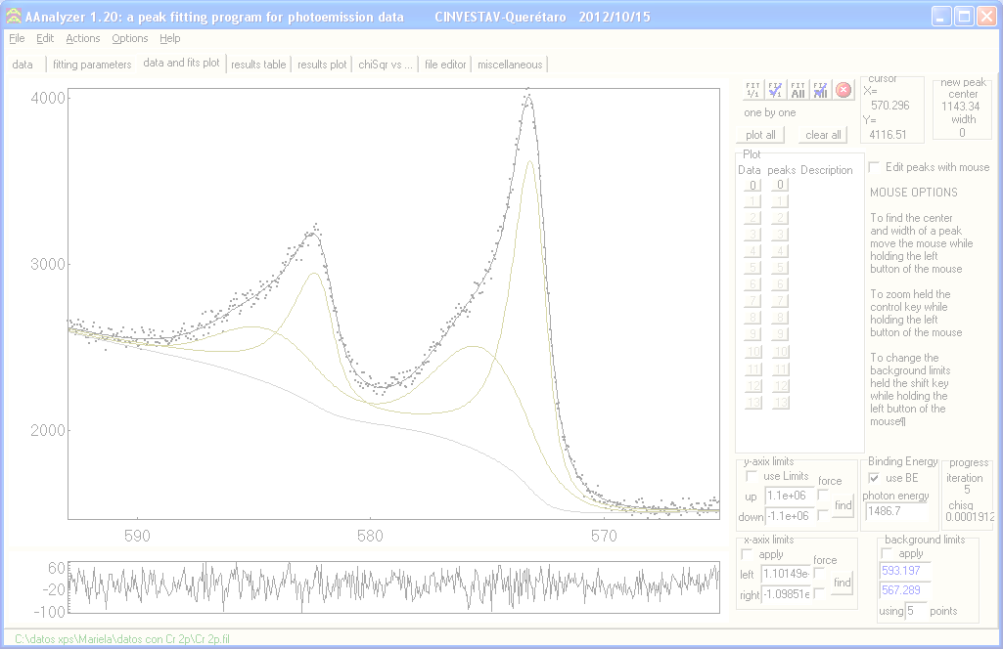
AAnalyzer®
Simple and Powerful Peak-Fitting
Getting AAnalyzer®
Note: If you require assistance for fitting a particular spectrum, please note that licensed users could receive prompt feedback on the fitting parameters of two data sets.
You can get a trial version (it has all the features; will last a month and requires internet connection to work) or
a licensed version.
The software runs on MS Windows. Mac users requires a Windows simulator.
Notes:
ésta va en http://rdataa.com/AAnalyzer/GettingAAnalyzer/

Slide 3
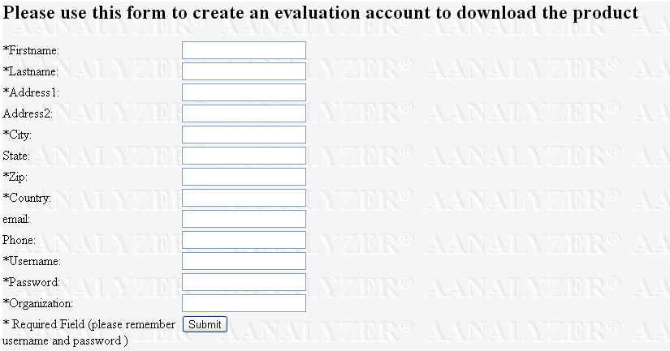
AAnalyzer®
Simple and Powerful Peak-Fitting
Getting AAnalyzer® (Trial Version)
From this page you can get a trial version (it has all the features; will last a month and requires internet connection to work).
You can get a licensed version from this other link.
The software runs on MS Windows. Mac users requires a Windows simulator.
Downloading Instructions
Notes:
ésta va en http://rdataa.com/AAnalyzer/GettingAAnalyzer/TrialVersion

Slide 4
AAnalyzer®
Simple and Powerful Peak-Fitting
Getting AAnalyzer® (Licensed Version)
From this page you can get a licensed version:
Once installed, it will not require internet connection to work.
The cost is US$500 per machine.
Special prices for group purchases.
The software runs on MS Windows. Mac users requires a Windows simulator.
Please fill the following form to place an order (you will receive a bill of statement as well as downloading and paying instructions):
First Name(s)
Last Name(s)
Organization 1
Organization 2
Address 1 (street and number)
Address 2
Address 3
Country
Phone
Email
Other billing data
Number of Copies of AAnalyzer®
Submit
Notes:
ésta va en http://rdataa.com/AAnalyzer/GettingAAnalyzer/LicensedVersion

Slide 5
AAnalyzer®
Simple and Powerful Peak-Fitting
User’s Manual
After downloading AAnalyzer you might want to go directly and give it a try since you might find it intuitive enough. However, some basics of the operation are described for the following links:
Opening and plotting data
Fitting with singlets
Correlating, fixing or freeing fitting parameters (coming soon)
Background options
Fitting with doublets
Saving options
Using the “results table” and “results plot”
Manipulating data
Calculating uncertainties
Fitting multiple files
Known bugs (coming soon)
Tutorials (coming soon)
Tutorials will be soon available with example-data to walk you through some standard procedures.
Notes:
ésta va en http://rdataa.com/AAnalyzer/UsersManual/

Slide 6
AAnalyzer®
Simple and Powerful Peak-Fitting
Special Topics on Photoemission Data Peak-Fitting
Why AAnalyzer
AAnalyzer contains all the standard options of a photoemission fitting program (e.g., true Voigt functions, Doniach-Sunjic line shape, Shirley and two and three-parameter Tougaard backgrounds, among others). All the parameters that it employs have a direct physical interpretation. In addition, it contains some special features that are unique to AAnalyzer®. These are described in the following links:
Active Background
The active background always provide better fits than the traditional method.
Peak-Shirley Background
This is a variant of the Shirley background that does not require iterations and neither the choice of two points. This makes the fit much less dependent on the operator.
Slope Background
This models in a very simply way the change on the slope of the background between the two sides of the peaks. In combinations with the Shirley background, provides excellent fits for a wide range of spectrum shapes.
Double-Lorentzian Line Shape
This provides an excellent integrable option to the Doniach-Sunjic line shape.
Simultaneous Fitting
This is an excellent tool for discriminating overlapping peaks.
All these features are easily available, giving the user the chance of taking advantage of them right away.
Notes:
ésta va en http://rdataa.com/AAnalyzer/SpecialTopics/

Slide 7
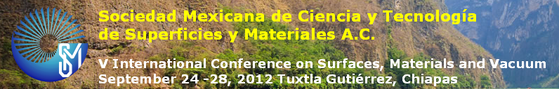


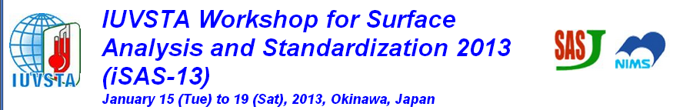
AAnalyzer®
Simple and Powerful Peak-Fitting
Related Events
Some presentations related to AAnalyzer:
Tuesday Afternoon, September 25, 2012, 16:10. The Active Shirley Background in XPS Data Analysis for the Thickness Assesment of Fe Oxide Layers. Mariela Bravo-Sanchez, Francisco Espinosa-Magaña, Alberto Herrera-Gomez.
Tuesday Afternoon, September 25, 2012, 17:50. A simpler alternative to the Tougaard background for XPS data fitting. Alberto Herrera-Gomez.
http://www.smctsm.org.mx/congresoXXXII/
Friday, October 12, 2012, 10:30. A non-iterative Shirley-type background for XPS data peak-fitting. A. Herrera-Gomez. CINVESTAV-Unidad Queretaro. Queretaro, 76230 Mexico. Invited Talk.
http://pvs.com.pk/vasscaa6/vasscaa.php
Monday Morning, October 29, 2012, 9:40am. Simplified Extrinsic Background for XPS Data Fitting, A. Herrera-Gomez.
Monday Afternoon, October 29, 2012, 4:40pm. AR-XPS Study of Al2O3/In-based IIIV Interfaces after Annealing under Vacuum at Low Temperature, E. Martinez, H. Grampeix, O. Desplats, CEA, LETI, MINATEC Campus, France, A. Herrera-Gomez, O. Ceballos-Sanchez, CINVESTAV-Unidad Queretaro, Mexico, J. Guerrero, K. Yckache, F. Martin, CEA, LETI, MINATEC Campus, France.
Tuesday Afternoon Poster Session. XPS Assessment of the Thickness of Fe Oxide Layers using Standard and Active Shirley Background, M. Bravo-Sanchez, CINVESTAV-Unidad Queretaro, Mexico, F. Espinosa-Magaña, CIMAV Unidad-Chihuahua, Mexico, A. Herrera-Gomez, UAM-Azcapotzalco and CINVESTAV-Queretaro, Mexico
Tuesday Afternoon Poster Session. Active Fitting for Optimized Shirley Background Determination, J. Muñoz-Flores, UAM-Xochimilco, Mexico, A. Herrera-Gomez, UAM-Azcapotzalco and CINVESTAV-Queretaro, Mexico
http://www2.avs.org/symposium/AVS59/pages/greetings.html
Practical Application of ARXPS to Materials Characterization. A. Herrera-Gomez. CINVESTAV-Unidad Queretaro. Queretaro, 76230 Mexico. Invited Talk.
http://www.sasj.jp/iSAS/iSAS13/index.html
Notes:
ésta va en http://rdataa.com/AAnalyzer/RelatedEvents/

Slide 8
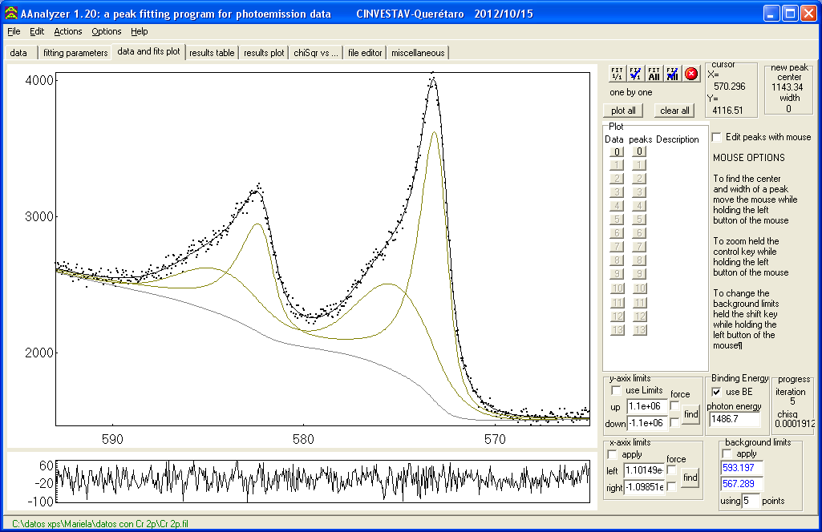
AAnalyzer®
Simple and Powerful Peak-Fitting
News
The expected launching of this web site is October 2012 with the 1.12 version of AAnalyzer®
Notes:
ésta va en http://rdataa.com/AAnalyzer/News/

Slide 9
AAnalyzer®
Simple and Powerful Peak-Fitting
Courses
Classroom and web-based courses on photoemission peak fitting will be announced in this page. You might ask for information about the following expected date at courses@rdataa.com.
Notes:
ésta va en http://rdataa.com/AAnalyzer/Courses/

Slide 10
AAnalyzer®
Simple and Powerful Peak-Fitting
Fitting Parameters Data-Base
AAnalyzer® users will soon have access to a user-generated peak-parameters data-base. In this free-access database it will be possible to find examples of fits to core-level peaks from almost every element, and to download the fitting parameters. It will be user-generated with room for discussion and for suggesting citing material.
Notes:
ésta va en http://rdataa.com/AAnalyzer/FittingParametersDataBase/

Slide 11
AAnalyzer®
Simple and Powerful Peak-Fitting
Fitting Parameters Feedback
For licensed AAnalyzer users: If you would like to have feedback about the fit of a particular spectrum, please send us your data and you will receive a suggestion through email.
Name
Institution
Position
Email
Choose File
column format text file
Possible core levels present in the spectrum
Upload
Notes:
ésta va en http://rdataa.com/AAnalyzer/FittingParametersDataBase/

Slide 12
AAnalyzer®
Simple and Powerful Peak-Fitting
Technical Support and Services
FAQs
Technical Services
The list of frequently asked questions will be populated accordingly.
Please let us know if your organization requires a special configuration to achieve your goals. Examples of Technical Services would be:
Email us at techsupport@rdataa.com or send us a message with your question.
Automatic conversion of your existing photoemission data file format to multicolumn format (appropriate for AAnalyzer’s input).
Integration onto existing software.
Special Training on the product.
Special personalization of the product.
Send
Scientific Services
Known Bugs
We will be pleased to assist to you in:
The list of known bugs will be populated accordingly.
Training / Collaboration over existing surface analysis of materials.
Special training on Data Analysis / Surface investigation.
Please do not hesitate to contact us about any of these services; we will be glad to help your organization in achieve any of your goals.
Notes:
ésta va en http://rdataa.com/AAnalyzer/TechnicalSuportAndServices/

Slide 13
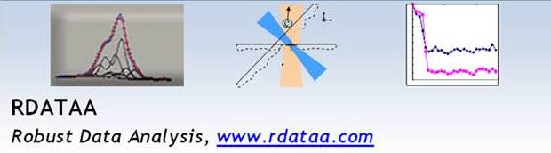

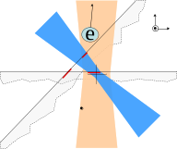
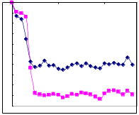
Products:
AAnalyzer®
Simple and Powerful Peak-Fitting
AAnalyzer® is a software for photoemission data peak-fitting:
Simple: new users becomes expert users in little time.
Powerful: it can be used for easy and difficult data.
XPSGeometry®
ARXPS Depth Profiling
XPSGeometry® is a software for:
Characterizing the equipment-related geometrical factors affecting the intensity in XPS instruments.
Characterizing the multilayer composition of nanofilms from ARXPS data.
AAligner®
Shift Correction
AAligner® is a software for correcting equipment-related and
sample-related peak-energy shifts in XPS data.
Notes:
ésta va en http://rdataa.com

Slide 14
Contact Information
Pascual Orozco 909-18, Col. San Felipe
Chihuahua, Chihuahua, C.P. 31203, Mexico
Phone +052 614 423 5004 Fax +052 614 423 5004
Email us:
admin@rdataa.com
sales@rdataa.com
techsupport@rdataa.com
Or send us a message
Send
Notes:
ésta va en http://rdataa.com/ContactInformation/

Slide 15
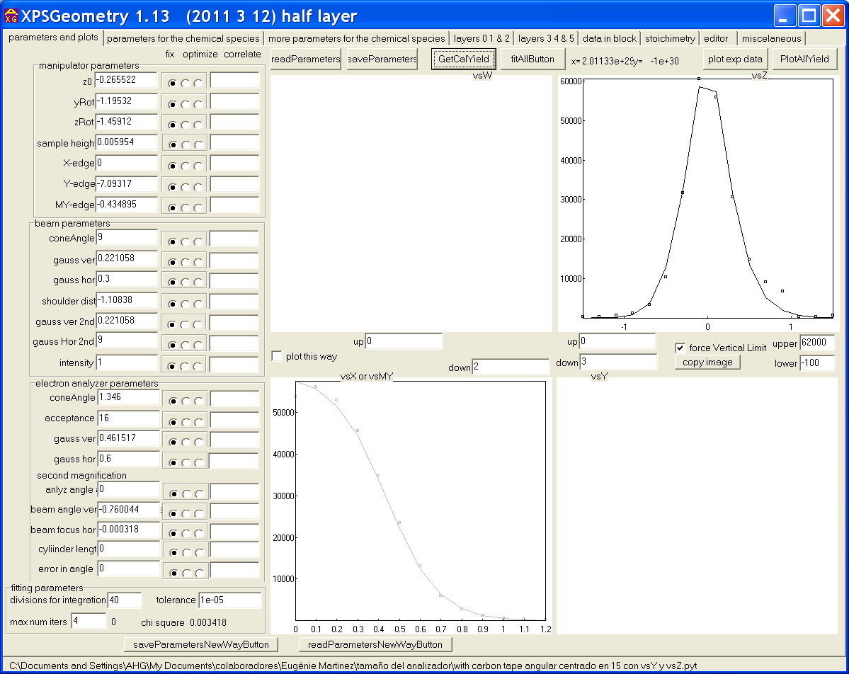
XPSGeometry®
ARXPS Depth Profiling
XPSGeometry® is a software for:
Characterizing the equipment-related geometrical factors affecting the intensity in XPS instruments.
Characterizing the multilayer composition of nanofilms from ARXPS data.
Related links:
“Instrument-related geometrical factors affecting the intensity in XPS and ARXPS experiments.” A. Herrera-Gomez, F.S. Aguirre-Tostado, P.G. Mani-Gonzalez, M. Vazquez-Lepe, A. Sanchez-Martinez, O. Ceballos-Sanchez, R.M. Wallace, G. Conti and Y. Uritsky. J. Electron Spectrosc. Relat. Phenom. 184 (2011) 487– 500.
http://www.sciencedirect.com/science/article/pii/S0368204811001010
Request Copy
“Characterization of geometrical factors for quantitative angle-resolved photoelectron spectroscopy.” E. Martinez, A. Herrera-Gomez, M. Allain, O. Renault, A. Faure, A. Chabli, and F. Bertin. J. Vac. Sci. Technol. A 30, p. 040605 (2012).
http://avspublications.org/jvsta/resource/1/jvtad6/v30/i4/p040605_s1?isAuthorized=no
Request Copy
“Self consistent ARXPS analysis for multilayer conformal films with abrupt interfaces”. Alberto Herrera-Gomez. Internal Report (Created: 1/2008. Last Update: 8/2008). http://www.qro.cinvestav.mx/~aherrera/reportesInternos/arxpsAnalysisSharpIntefaces.pdf
Download
crear (yo la monitoro)
Please request a copy of XPSGeometry to xpsgeomety@rdataa.com
Notes:
ésta va en http://rdataa.com/xpsgeometry

Slide 16
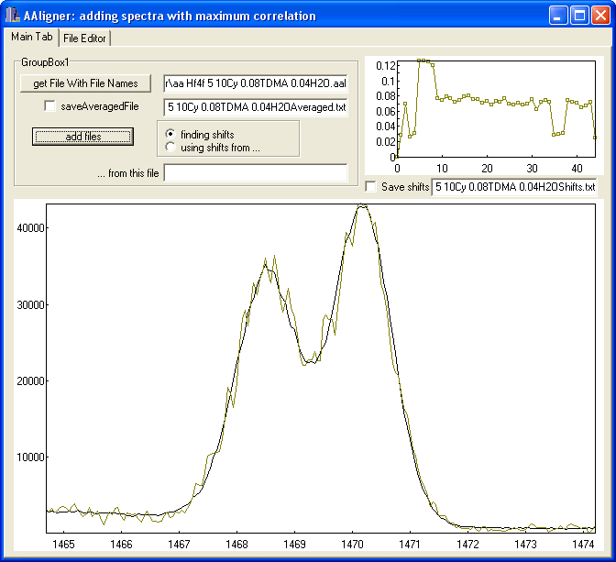
AAligner®
Shift Correction
AAligner® is a software for correcting equipment-related and
sample-related peak-energy shifts in XPS data.
Related links:
“Correction of equipment-related and sample-related peak-energy shifts”. (Created: 8/2010. Last Update: 1/2011)
http://www.qro.cinvestav.mx/~aherrera/reportesInternos/fixingShifts.pdf
crear (yo la monitoro)
Please request a copy of AAligner® to aaligner@rdataa.com
Notes:
ésta va en http://rdataa.com/aaligner

